Slide 1
UNO Lending Library
Tareq Alomar, Cody Barrett, Jacob Levy, Nick Volenec

Slide 2
Project Overview
The lending library project is an attempt to solve the following problem: There exists a program where University of Nebraska personnel loan out equipment to local K-12 schools. Currently this is an entirely manual process, requests are submitted via emailed and fulfilled manually by University of Nebraska personnel. Our goal is to create a web interface that will streamline request, processing, and user management.

Slide 3
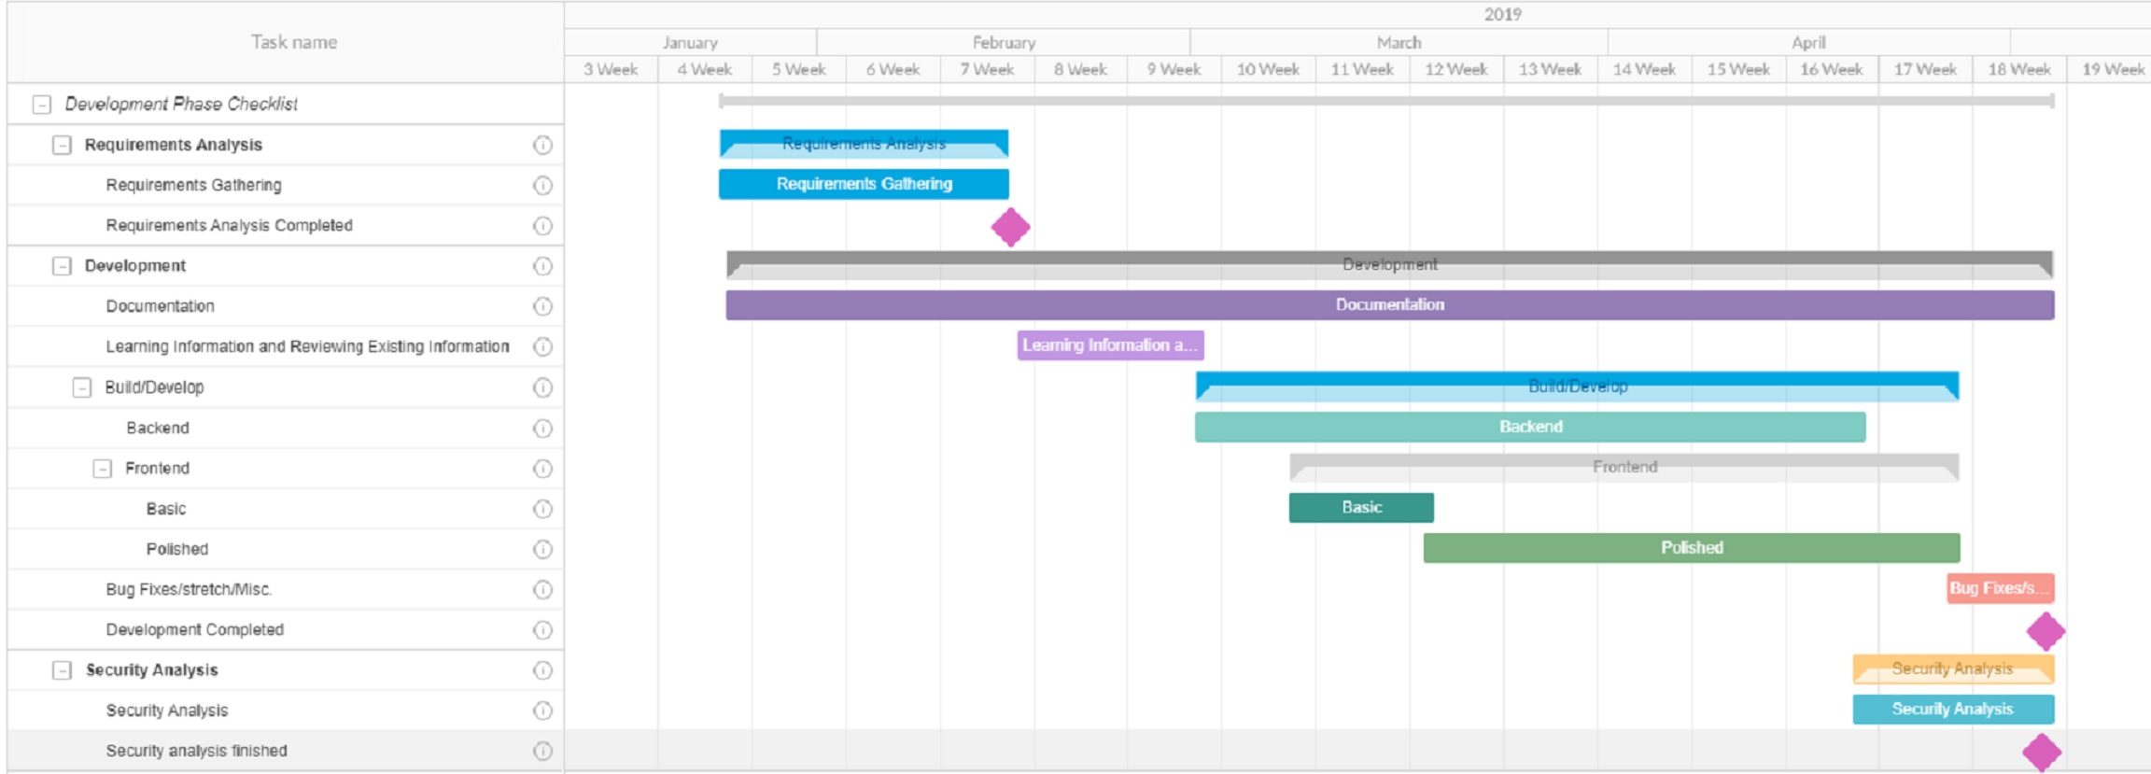
Project Timeline

Slide 4
Technology
Our solution will be built in a Django-Ember environment built on top of Docker with a PostgreSQL backend.
Docker is a platform for operating system level virtualization
Django is an open-source python based framework for rapid web development
Ember is an open-source javascript framework
PostgreSQL is an open-source Relational Database system

Slide 5
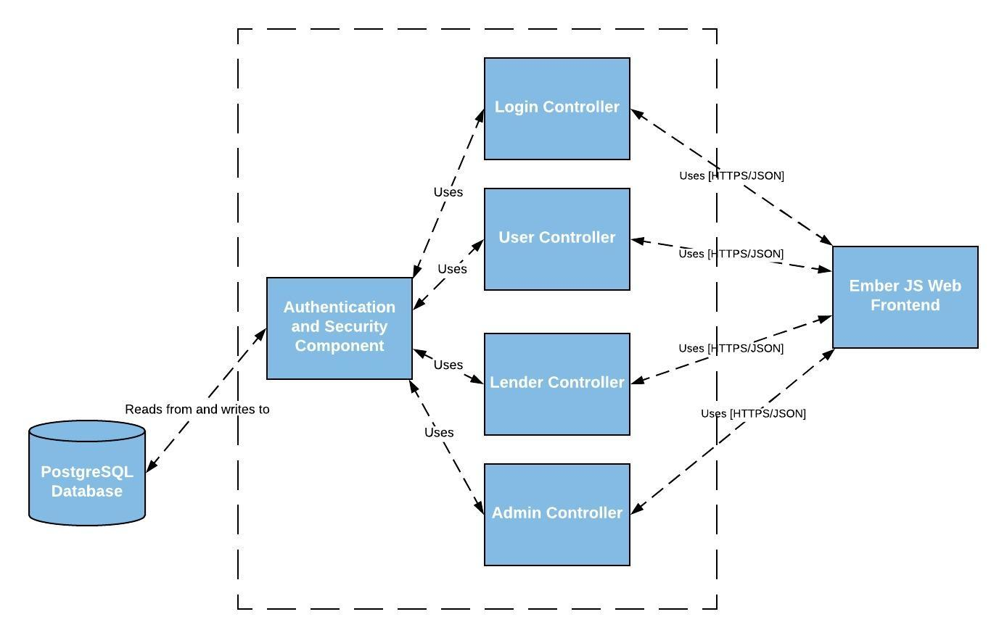
C4 Diagram - Level 3

Slide 6
Risk | Input | Likelihood
Illness of team member(s) | 4 | 4
Lack of Technical Proficiency | 3 | 4
Hardware Failure | 5 | 2
Inadequate Documentation | 4 | 1
Act of God | 8 | 1
Risk List

Slide 7
Security
Since this is a cybersecurity capstone project, one of our focuses is to create a system with robust security.
An initial list of security features we intend to implement:
CSRF tokens on all forms
A strict Content Security Policy to prevent code injection
All SQL queries will be built using prepared statements
Strong password policy
Robust access/activity logging
The JSON interface between the Django and Ember layers must be inaccessible to outside users

